Slide 1
Pick a dish app
By team #5

Slide 2

idea
This app is the main stage to share opinions in dishes that we take to our social event like Friday family meeting ;)
You can view dishes' shops
You can add tips for dishes added by you or other user
You can know what appropriate occasion to take this dish for !
you can view other users opinion and rating
Images and location maybe added later

Slide 3
Platform
We want to build this app for ios and android also if we have time to do that

Slide 4
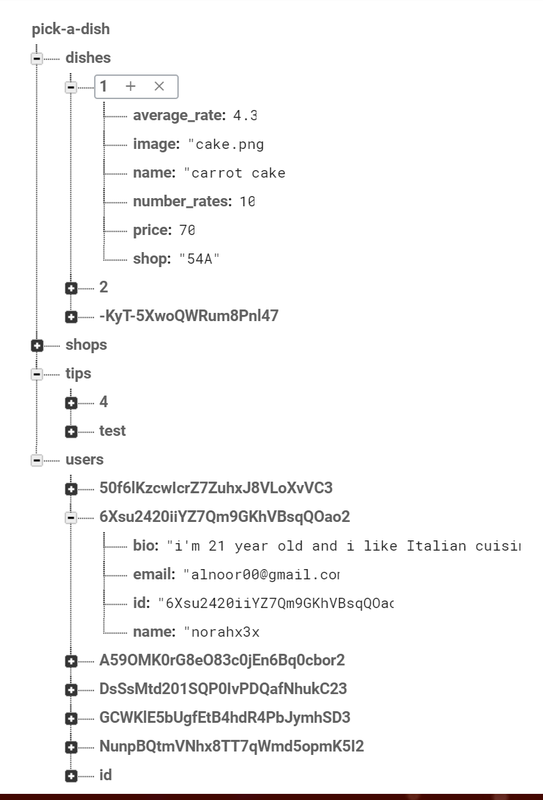
tools
We used firebase database as backend for our app “like”
We used ionic icons for app icons
We used colorlovers for color matching

Slide 5
Experience
Advantages:
Ionic View
Web Developers Can Be Mobile Developers (HTML, CSS, JS)
Disadvantages:
Command line
Few up to date tutorials

Slide 6
demo

Slide 7
What we have done ?
Signup
login
Skip
List of dish (home page for all users)
Profile page
Settings page
Add new dish

Slide 8
Thanks ☺
Pray for us

